Slide 1
.NET MAUI Enterprise Applications
Dan Ciprian Ardelean
Microsoft MVP
dan@mahiz.it Twitter: @danardelean

Slide 2
A long time ago…
Notes:
2002

Slide 3
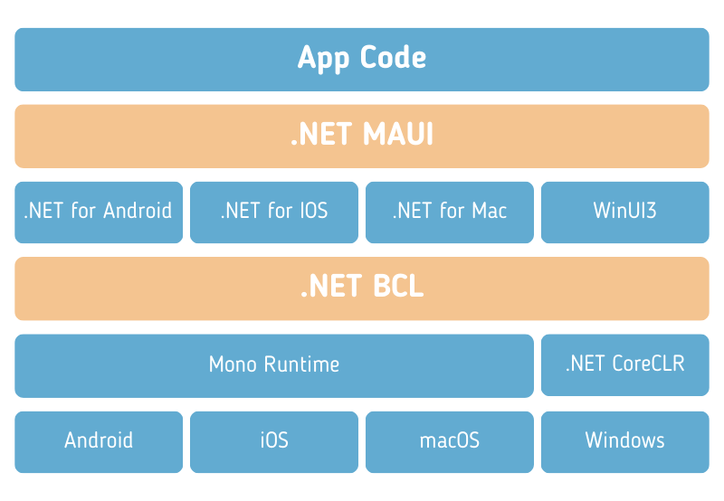
.NET iOS & .NET Android

Slide 4
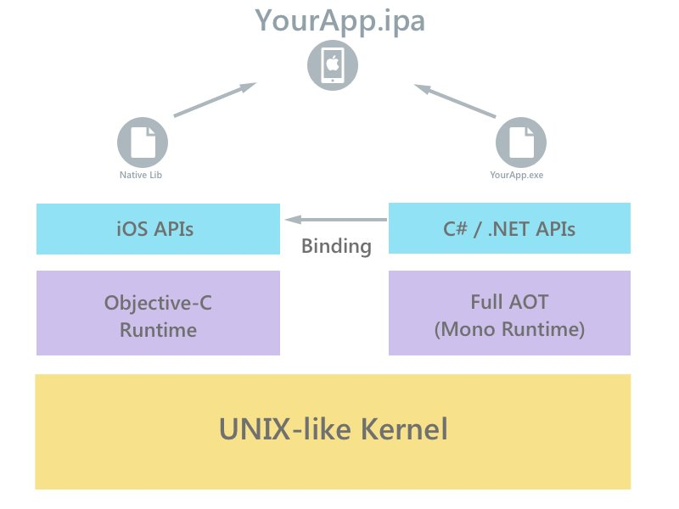
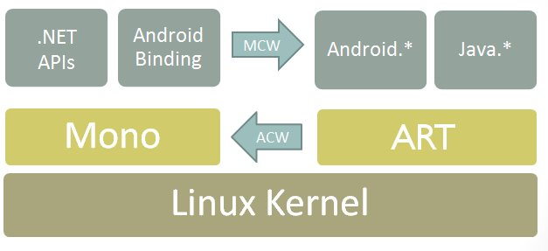
.NET iOS & .NET Android

Slide 5
Mobile Application Penetration Test

Slide 6
What The Hack
M10-Janus (CVE-2017-13156)
M7 Missing of weak code obfuscation
M7 SSL Pinning Bypass
M7 Weak or missing jailbreak countermeasures
M7 Missing Integrity check
M8 Tap Jacking
M7 Bypass screenshot restriction

Slide 7
Why
Identify
Evaluate
Provide recommendations
Integrate into the development cycle

Slide 8
Open Worldwide Application Security Project
MASVS
MASTG
MASWE
Mobile Application Security Verification Standard
https://mas.owasp.org/MASVS/
Mobile Application Security Testing Guide
https://mas.owasp.org/MASTG/
Mobile Application Security Weakness Enumeration
https://mas.owasp.org/MASWE/
MAS Checklist https://mas.owasp.org/checklists/

Slide 9
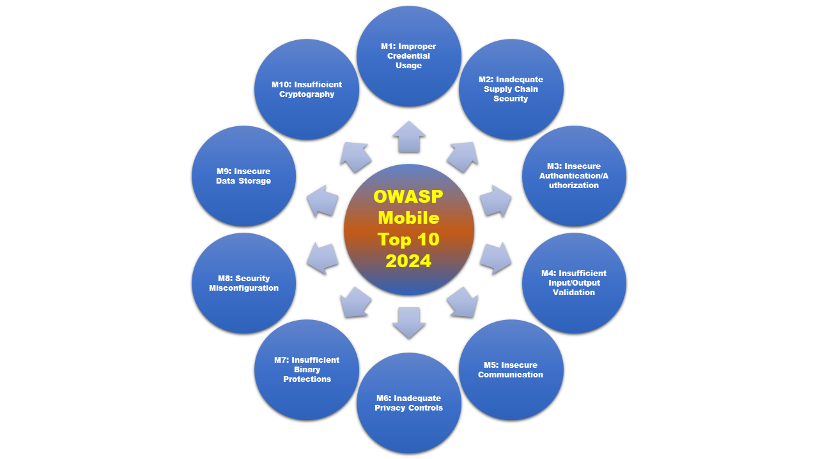
OWASP Mobile Top 10 2024
https://owasp.org/www-project-mobile-top-10/

Slide 10
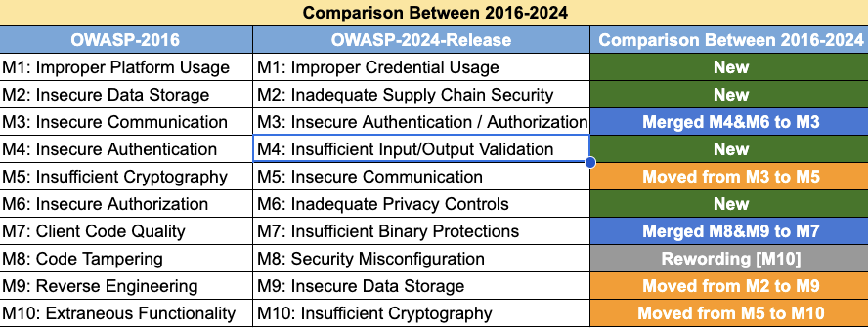
OWASP Mobile Top 10 2024
https://owasp.org/www-project-mobile-top-10/

Slide 11
RASP
Runtime Application Self Protection

Slide 12






Notes:
Root/Jailbreak (e.g., su, Magisk, unc0ver, check1rain, Dopamine)
Hooking framework (e.g., Frida, Shadow)
Untrusted installation method
App/Device (un)binding

Slide 13



Resources
https://frida.re
https://github.com/NorthwaveSecurity/fridax
Frida
Frida X
https://codemerx.com
https://mas.owasp.org
CodeMerx Decompile
OWASP Mobile Application Security
https://www.eziriz.com/dotnet_reactor.htm
.NET Reactor

Slide 14
.NET MAUI Day
Thank you

